Slide 1
Electromagnetism
Year 12

Slide 2
Page Setup
Set up the first page of every lesson like this and rule a column line for every page after the first page that is used during the lesson.
Focus: State the Chapter Number, Title and the page numbers
(3 lines).
Keywords: During the lesson write out your own keywords used during the lesson. (8 lines)
Context: During the lesson write in this section what this topic relates to in the ‘real’ world. How is this content used to better society? (5 lines)

Slide 3
ELECTROMAGNETIC INDUCTION
Chapter 5.1
Page 124 - 133

Slide 4
INDUCING A CURRENT

Slide 5
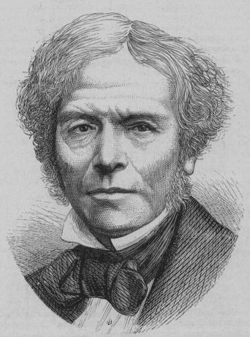
What is Electromagnetic Induction?
Electromagnetic Induction is the process of using magnetic
fields to produce voltage, and in a complete circuit, a current.
Michael Faraday first discovered it, using some of the works
of Hans Christian Oersted. His work started at first using different combinations of wires and magnetic strengths and currents, but it wasn't until he tried moving the wires that he got any success.
It turns out that electromagnetic induction is created by just that –
the moving of a conductive substance through a magnetic field

Slide 6
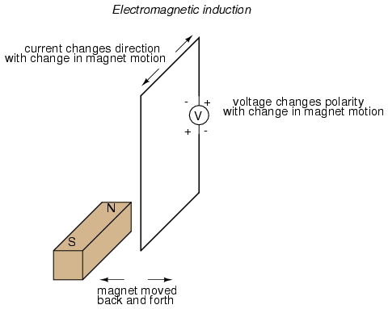
Magnetic Induction
As the magnet moves back and forth then a current is said to be INDUCED in the wire.

Slide 7
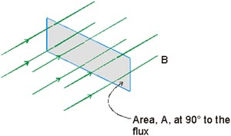
Magnetic Field Strength (Flux Density)
The magnetic flux is the strength of the magnetic field in a given area.
We generally define an
AREA vector as one that
is perpendicular to the
surface of the material.
Therefore, you can see in
the figure that the AREA
vector and the Magnetic
Field vector are PARALLEL.
Area vector perpendicular to the surface area.

Slide 8
Magnetic Field Strength (Flux Density)
The magnetic flux is the strength of the magnetic field (or magnetic flux density) in a given area.
φ - magnetic flux (Wb or T m²)
B – magnetic field strength (T)
A – area (m²)
φ = B A
Area vector perpendicular to the surface area.

Slide 9
Calculating Flux When Area is Not Perpendicular to Field
The flux φ penetrating the area A when the normal vector n makes an angle of θ with the B-field is:
n
A
θ
φ = B A cosθ
α
B
The angle θ is the complement of the angle a that the plane of the area makes with B field. (Cos θ = Sin α)
φ = B A cosθ = B A sinα

Slide 10
Example 5.1a: A current loop has an area of 40 cm² and is placed in a 3 T magnetic field at the given angles. Find the flux φ through the loop in each case.
Calculating Flux
Front View Side Views
× × × × × × × × × × × × × × × × × × × × × × × × × × × × × × × × × × ×
n
A
n
n
θ
A = 40 cm²
(a) θ = 0⁰
(b) θ = 90⁰
(c) θ = 60⁰
(a) φ = BA cos 0⁰ = (3 T)(0.004 m²)(1); φ = 12.0 mWb
(b) φ = BA cos 90⁰ = (3 T)(0.004 m²)(0); φ = 0 Wb
(c) φ = BA cos 60⁰ = (3 T)(0.004 m²)(0.5); φ = 6.00 mWb

Slide 11
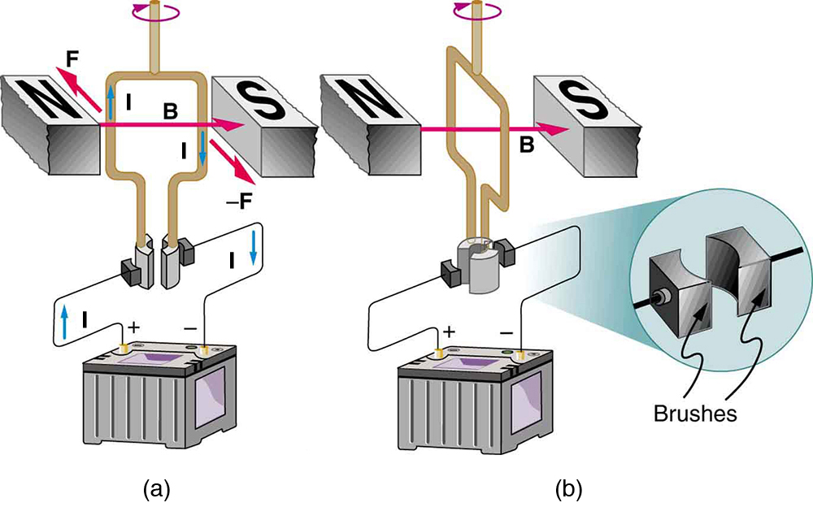
Magnetic Field Strength (Flux Density)
Example 5.1b: The magnetic field shown has a magnitude of 4.2 × 10⁻⁴ T and its direction is horizontal and to the East. The coil is 30 cm wide and 45 cm high. Calculate the total flux passing through the coil if:
The plane of the coil is at right angles to the field (fig b).
The plane of the coil is parallel to the field (fig a).
The plane of the coil is 45º to the field.

Slide 12
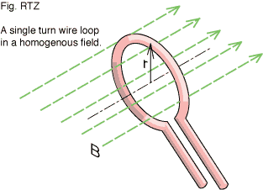
Magnetic Field Strength (Flux Density)
Example 5.1c: The magnetic field in the
picture illustrated has a magnitude of
2.8 × 10⁻⁵ T and its direction is horizontal
and to the North. The coil illustrated has
A radius of 25 cm. Calculate the total flux
passing through the coil if;
The plane of the coil is at right angles
to the field.
The plane of the coil is at parallel to the field.
The plane of the coil is at 45º to the field.
The plane of the coil is at 30º to the field.

Slide 13

Magnetic Field Strength (Flux Density)
Example 5.1d: At this particular point in W.A the magnetic flux density was found to be 6.2 × 10⁻⁶ T at an angle of 70º to the horizontal. A student would like to construct an experiment using a coil whose area could encompass one weber of flux.
Construct a diagram showing this information.
Calculate the minimum area of such a coil.
Explain clearly the orientation required
for such a coil to achieve this.
Is this experiment likely to cause any
particular difficulties?

Slide 14
Induced Current
The flux φ penetrating the area A changes over a period of time will determine the current induced in the area the coil contains.
n
A
θ
α
I_{ind} = φ
t
B

Slide 15
Magnetic Field Strength (Flux Density)
Example 5.1e: A student places a horizontal 5.00 cm square coil of wire into a uniform vertical magnetic field of 0.100 T.
a) How much flux cuts through the coil?
She then pulls the coil out of the field at such a rate that it takes 1.00 s for the coil to lose all the flux. While the coil is coming out of the field, she finds that a current of +2.00 mA is registered on the ammeter connected to it.
b) If she puts the coil back into the flux at the same rate, what current will she observe?
c) If she pulls it out again, but twice as fast as before, what current will be induced?
Now she steadily rotates the loop while it is fully in the field in such a way that it takes 2.00 s to rotate through 180.0°.
d) Describe the current that will be induced.

Slide 16
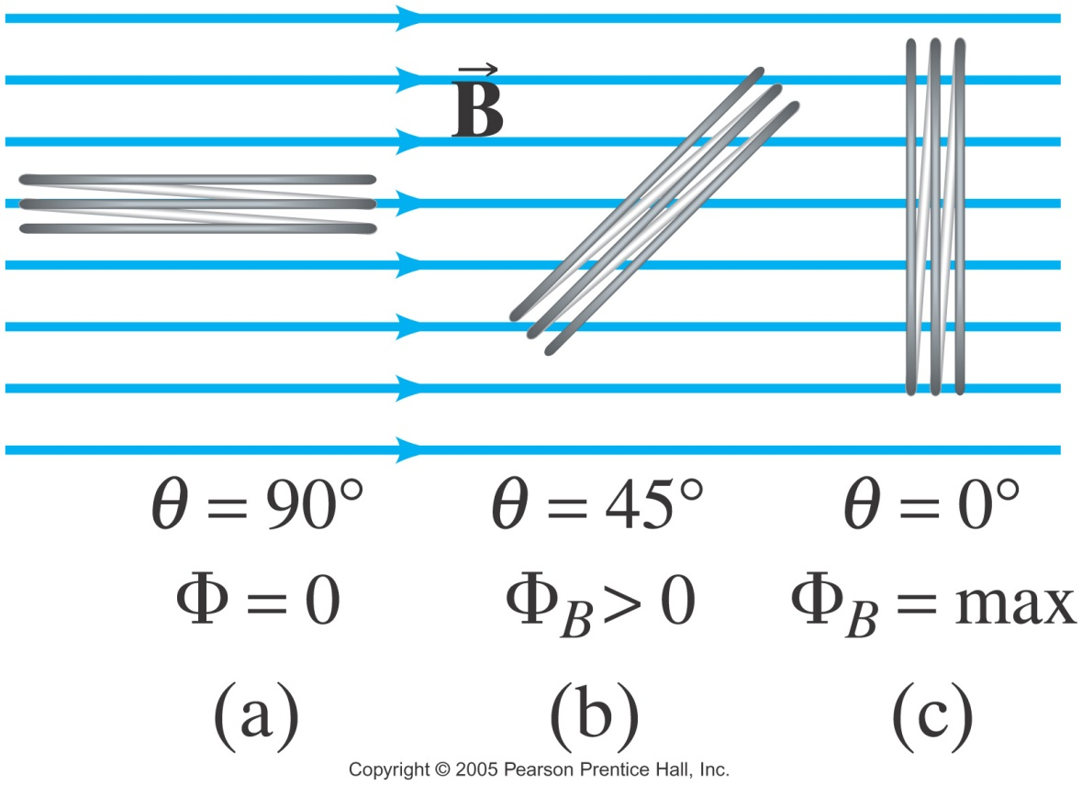
Flux when Area is not Perpendicular to Field

Slide 17
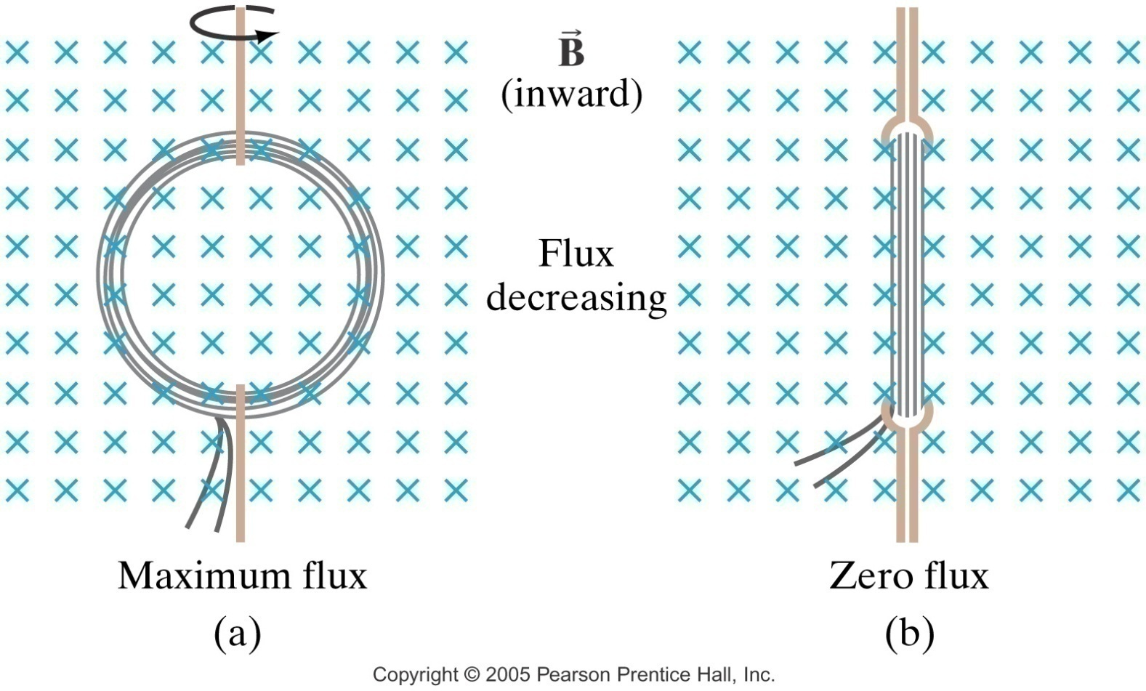
Magnetic Field Strength (Flux Density)
Magnetic flux will change if the angle between the loop and the field changes:
As this coil spins on its axis, it moves between maximum flux and minimum (or zero) flux

Slide 18
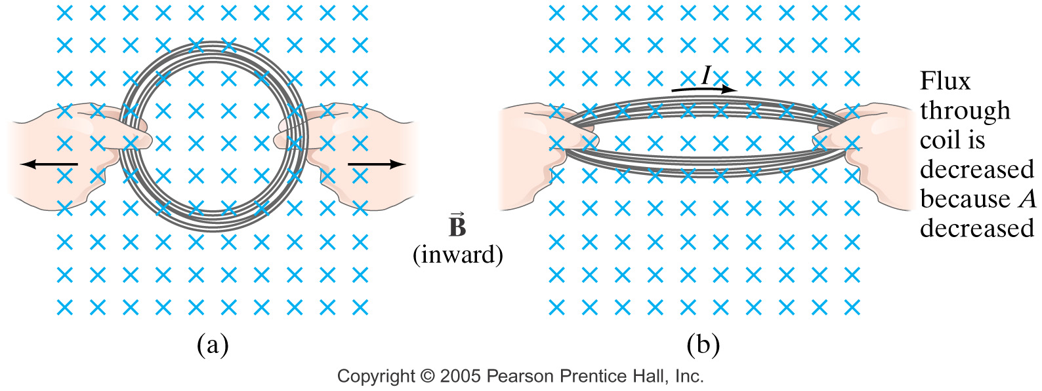
Magnetic Field Strength (Flux Density)
Magnetic flux will change if the area of the loop changes.
Magnetic flux will change if the magnetic field strength changes:
φ = B A cosθ

Slide 19
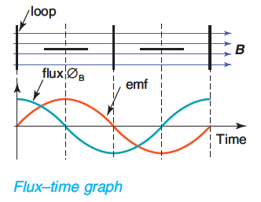
Magnetic Induction
Example 5.1f: The amount of magnetic flux passing through the loop varies like a sine wave. The induced EMF across the ends of the loop is equal to the change of magnetic flux with time.
φ = BA cos θ
EMF (ε) = -N Δφ .
Δt
where Δφ = φ_{f} − φ_{i}
cos 0 = 1
cos 90 = 0
cos 180 = -1
cos 270 = 0

Slide 20
FARADAY’S LAW

Slide 21
Faraday’s Law for a Coil
The magnitude of the EMF (voltage, potential difference) induced in the rotating coil in a magnetic field is directly proportional to the rate of change of flux threading the coil.
Since we are dealing with time here were a talking about the RATE of CHANGE of FLUX, which is called Faraday’s Law.
ε – induced voltage (V)
N – number of turns of coil
Δφ – change in flux (Wb)
Δt – change in time (s)
the negative sign indicates the direction of the induced EMF.

Slide 22
Faraday’s Law for a Coil
Example 5.1g: How is the EMF induced different in the following cases:
The flux is increased from 100 Wb to 400 Wb in 0.5 seconds
The flux is decreased from 400 Wb to 100 Wb in 0.5 seconds

Slide 23
Example 5.1h: A coil has 200 turns of area 30 cm². It flips from vertical to horizontal position in a time of 0.03 s. What is the induced EMF if the constant B-field is 4 mT?
Faraday’s Law for a Coil
N = 200 turns
n
θ
B
N
S
B = 4 mT; 0⁰ to 90⁰

Slide 24
Faraday’s Law for a Coil
Example 5.1i: A coil with 200 turns of wire is wrapped on an 18.0 cm square frame. Each turn has the same area, equal to that of the frame, and the total resistance of the coil is 2.0 Ω . A uniform magnetic field is applied perpendicularly to the plane of the coil. If the field changes uniformly from 0 to 0.500 T in 0.080 s, find the magnitude of the induced emf in the coil while the field has changed as well as the magnitude of the induced current.

Slide 25

Faraday’s Law for a Wire (Motional EMF in a Wire)
I
F_{onI}
Force F on charge q in wire:
F = qvB
Work = FL = qvBL
× × × × × × ×
× × × × × × ×
× × × × × × ×
× × × × × × ×
B
I
v
L
v
E
x
If wire of length L moves with velocity v an angle θ with B:
B
θ
v
Induced Emf E

Slide 26
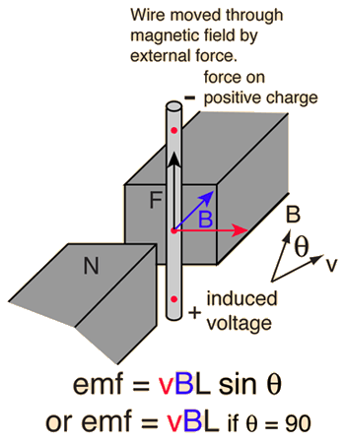
Faraday’s Law for a Wire (Motional EMF in a Wire)

Slide 27
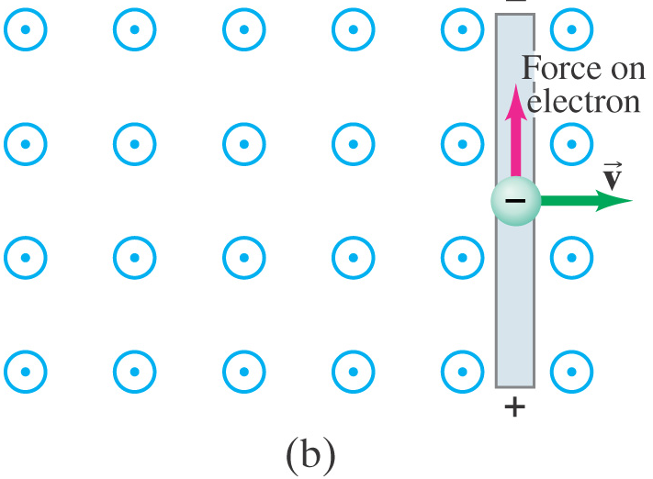
Faraday’s Law for a Wire (Motional EMF in a Wire)
Conventional Current flows in the opposite direction to the flow of electrons.

Slide 28
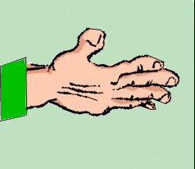
Example 5.1j: A 0.20 m length of wire moves at a constant speed of 5 m s⁻¹ in at 140⁰ with a 0.4 T magnetic field. What is the magnitude of the induced emf in the wire?
Faraday’s Law for a Wire
North
North
v
v
I
θ
B
B
South
South

Slide 29
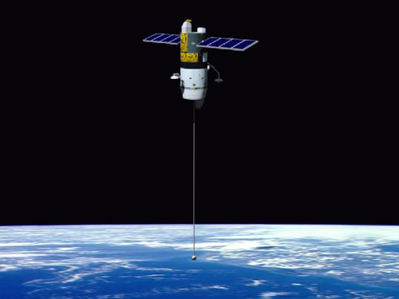
Faraday’s Law for a Wire
Example 5.1k: An airplane with a wing span of 30.0 m flies parallel to the Earth’s surface at a location where the downward component of the Earth’s magnetic field is 0.60 x10⁻⁴ T. Find the difference in potential between the wing tips is the speed of the plane is 250 m/s.
In 1996, NASA conducted an experiment with a 20,000-metre conducting tether. The orbiting tether generated a potential of 3,500 volts. This conducting single-line tether was severed after five hours of deployment. It is believed that the failure was caused by an electric arc generated by the conductive tether's movement through the Earth's magnetic field.

Slide 30
Faraday’s Law for a Wire
Example 5.1l: A jet airliner is flying due South in the northern geographical hemisphere where the Earths magnetic field has a flux density of 5.2 x 10⁻⁵ T at an angle of dip of 54º.
Sketch the alignment of the Earths magnetic field lines relative to the jet liner.
Calculate the EMF induced across the 60 metre wingspan if the jet has a speed of 140 m s⁻¹.
Where would there be a build up of electrons.

Slide 31
LENZ’S LAW

Slide 32
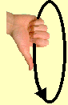

Lenz’s Law
An induced current will be in such a direction as to produce a magnetic field that will oppose the motion of the magnetic field that is producing it.
Induced B
Left motion
I
Right motion
Induced B
N
S
N
S
I
Flux increasing to left induces loop flux to the right.
Flux decreasing by right move induces loop flux to the left.

Slide 33
Induced current in a Wire
Whenever a current is induced in a wire moving in a magnetic filed, there will be a force which will oppose the motion.
The direction of motion will be opposed by a force (Lenz Law). Using the Right Hand Rule the direction of Force can be found, hence the motion of the wire is opposite.
x x x x x x
x x x x x x
x x x x x x
x x x x x x
x x x x x x
B
v
F
I

Slide 34
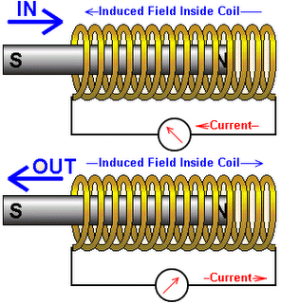
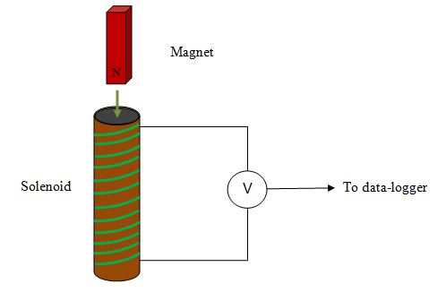
Induced Current in a Coil
If a magnet is moved towards or away from a coil, a small EMF (electromotive force) is created.
The EMF will cause a current to flow
(if the current is complete).

Slide 35
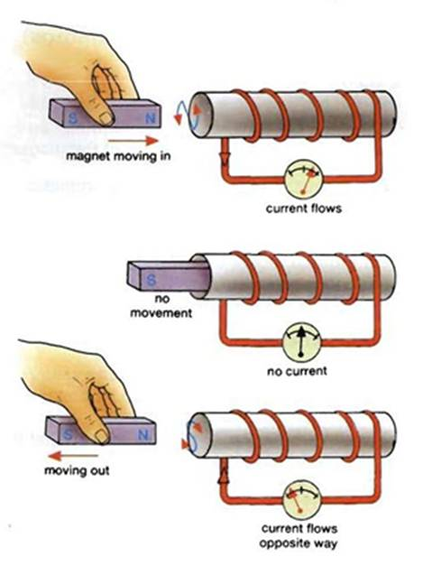
Induced Current in a Coil - Solenoids
As the magnet moves towards the solenoid, it creates a “North end” of the solenoid closest to the magnet.
As the magnet moves away from the solenoid, it creates a “South end” of the solenoid closest to the magnet.

Slide 36
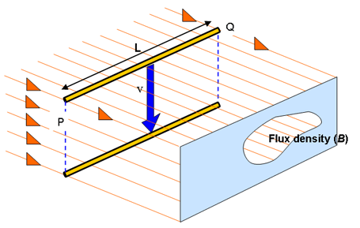
Lenz Law
Example 5.1m: A wire falling between magnets, as shown. Use Lenz’s Law and Faraday’s Law to explain what is happening.
Faraday: The wire falling through the air between the magnets will result in a current flowing from Q to P, where EMF = v B l and EMF = I R.
Lenz: The motion of the wire results in an opposing force. This force increases the required work to be done, hence slowing the motion and reducing the EMF. This reduces the force and hence allows the velocity to increase again.

Slide 37
Lenz’s Law
Lenz's law gives the direction of the induced emf and current resulting from electromagnetic induction. The law provides a physical interpretation of the choice of sign in Faraday's law of induction, indicating that the induced emf and the change in flux have opposite signs.

Slide 38
Lenz’s Law
Example 5.1n: Using two non-magnetic pipes (one plastic and one Aluminium), drop a “rare earth” magnet down each pipe at the same time and observe what happens.
The plastic pipe has no free electrons, hence a current cannot be induced.
The Aluminium pipe has free electrons, so as the magnet falls through, this induces a current (Faraday’s Law). This current results in a force opposing the direction of motion (Lenz’s Law).
The greater the speed, then the greater the force. The magnet speed increases due to gravity, but this increases the opposing force, which then slows the magnet down, which then reduces the force. Gravity takes over and the speed increases again, which increases the opposing force, which slows it down. This continues until equilibrium is achieved.

Slide 39
Example 5.1o: Use Lenz’s law to determine direction of induced current through R if switch is closed for circuit below (B increasing).
Lenz’s Law
Close switch. Then what is direction of induced current?
R

Slide 40
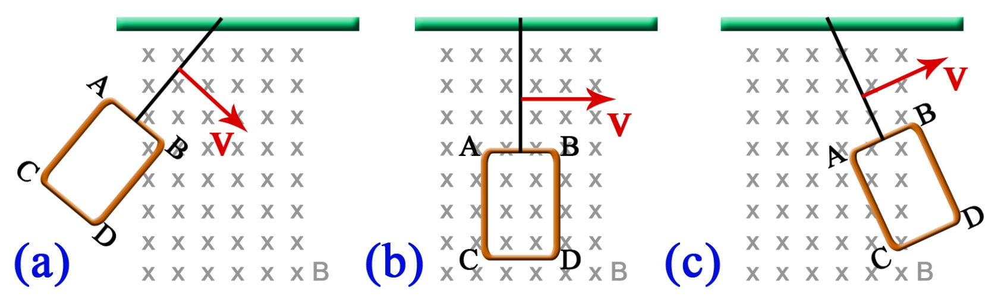
Example 5.1p: A rectangular copper coil ABCD is attached by string to a support so that it can swing like a pendulum through a magnetic field as shown. The coil is initially released as shown in (a) and allowed to swing through the field. a) In each of the positions shown above determine the direction of the current flowing (if any) as the copper coil moves through the magnetic field. b) It is noticed that the system comes to a stop after only two or three oscillations, even though the pendulum is freely suspended. Why is this and where has the apparent loss of energy gone?
Lenz’s Law

Slide 41
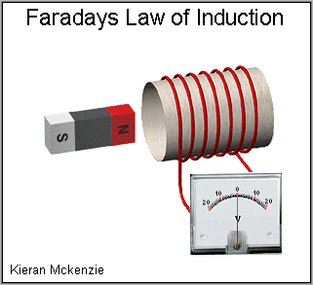
Lenz’s Law & Faraday’s Law

Slide 42
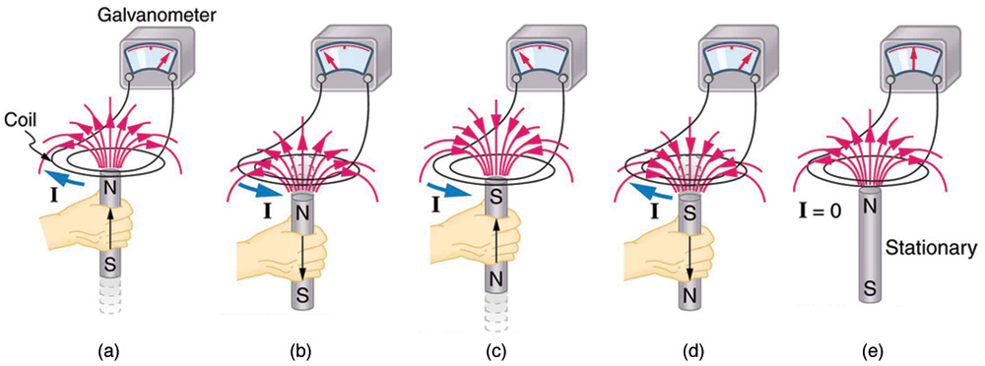
Lenz’s Law & Faraday’s Law

Slide 43
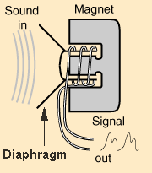
Microphones
A microphone works when sound waves enter the filter of a microphone. Inside the filter, a diaphragm is vibrated by the sound waves which in turn moves a coil of wire wrapped around a magnet.
The movement of the wire in the magnetic field induces a current in the wire. Thus sound waves can be turned into electronic signals and then amplified through a speaker.

Slide 44
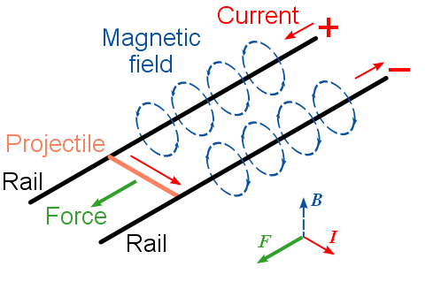
Motional EMF – The Rail Gun
A railgun consists of two parallel metal rails (hence the name) connected to an electrical power supply. When a conductive projectile is inserted between the rails (from the end connected to the power supply), it completes the circuit. Electrons flow from the negative terminal of the power supply up the negative rail, across the projectile, and down the positive rail, back to the power supply.

Slide 45
Motional EMF – The Rail Gun
In accordance with the right-hand rule, the magnetic field circulates around each conductor. Since the current is in opposite direction along each rail, the net magnetic field between the rails (B) is directed vertically. In combination with the current (I) across the
projectile, this produces a magnetic force which accelerates the projectile along the rails. There are also forces acting on the rails attempting to push them apart, but since the rails are firmly mounted, they cannot move. The projectile slides up the rails away from the end with the power supply.

Slide 46
In summary
Faraday’s Law is basically used to find the MAGNITUDE of the induced EMF. The magnitude of the current can then be found using Ohm’s Law provided we know the conductor’s resistance.
Lenz’s Law is part of Faraday’s Law and can help you determine the direction of the current provided you know HOW the flux is changing.

Slide 47
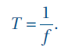
Peak, RMS and Peak-to-Peak Voltages Terminology
An alternating current (AC) is an electric current that reverses direction at short, regular intervals.
A direct current (DC) is an electric current that flows in one direction only.
The period, T, of a periodic wave is the time it takes a source to produce a complete wave. This is the same as the time taken for a complete wave to pass a given point.
The frequency, f, of a periodic wave is the number
of times that it repeats itself every second.

Slide 48
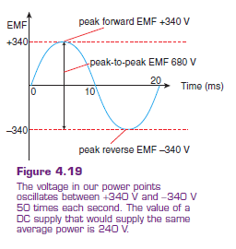
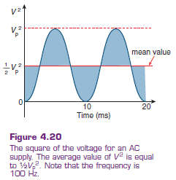
Peak, RMS and Peak-to-Peak Voltages Terminology
The amplitude of a periodic disturbance is the maximum variation from zero.
The peak voltage, V_{peak}, is the amplitude of an alternating voltage.
The peak current, I_{peak}, is the amplitude of an alternating current.

Slide 49
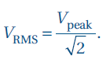
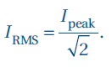
Peak, RMS and Peak-to-Peak Voltages Terminology
The RMS (root mean square) voltage, V_{RMS}, is the value of the constant DC voltage that would produce the same power as AC voltage across the same resistance.
Similarly, IRMS is the value of a DC current that generates the same power as an AC current through the same resistance:

Slide 50
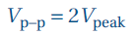
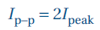
Peak, RMS and Peak-to-Peak Voltages Terminology
The peak-to-peak voltage, V_{p-p}, is the difference between the maximum and minimum voltages of a DC voltage.
Similarly;
Example 5.1q: A digital multimeter gives a measurement of 6.3 V for the RMS value of an AC voltage. A CRO is used to measure the
peak-to-peak voltage. What value do you expect?

Slide 51
Peak, RMS and Peak-to-Peak Voltages
Example 5.1r: A 60.0 W light bulb supplied with 240 V AC uses 60.0 J every second, but the instantaneous power varies from 0.00 to 120 W and current oscillates between 0.00 to 0.250 A (RMS), 100 times every second. Justify and explain this statement.
Note:
½ V_{AC}² = V_{DC}²
Example 5.1s: The AC power in power lines oscillates at +340 V to -340 V in Australia. What is the DC power rating that a toaster is to be designed for?

Slide 52
Homework, Context & Keywords
Context: How is this content used to better society?
The relationship between Faraday’s Law and Lenz’s Law means braking systems can be developed to reduce frictional wear.

Slide 53
Homework, Context & Keywords
Key Words
Magnetic Induction
Current
Magnetic Flux
Induced Current
Magnetic Field Strength
Flux Density
EMF
Turns
Faraday’s Law
Lenz’s Law
Speakers
Rail Gun

Slide 54
Homework, Context & Keywords
Homework
Complete all questions from Set 5.1 - due first lesson next week.
Read Chapter 5.2, page 134-140 and answer
Q1 & Q2 Set 5.2
by next lesson.

Slide 55
Page Setup
Set up the first page of every lesson like this and rule a column line for every page after the first page that is used during the lesson.
Focus: State the Chapter Number, Title and the page numbers
(3 lines).
Keywords: During the lesson write out your own keywords used during the lesson. (8 lines)
Context: During the lesson write in this section what this topic relates to in the ‘real’ world. How is this content used to better society? (5 lines)

Slide 56
GENERATORS
Chapter 5.2
Page 134 - 140

Slide 57
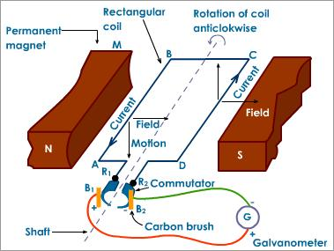
Components
A commutator can be slip rings (AC) or split rings (DC).

Slide 58
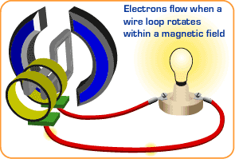
Electric Generation
Generation of electricity is achieved by inducing a current in a conductor by moving the coil in a magnetic field. When moved perpendicular to the magnetic field, then a maximum EMF is generated.

Slide 59
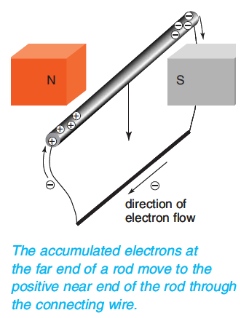
Generators
EMF is used to produce a current. The rod inside the magnetic filed and the wires outside the magnetic field give the electrons a path of low-resistance to go around (to the positively charged end).
Once the electrons reach the positive end, they will be
back in the magnetic field falling down with the metal
rod, and will again experience a magnetic force
pushing them to the far end of the rod. The electrons
will then move around the circuit for a second time.
The electrons will continue to go around as long as
the wire is falling through the magnetic field. An
electric current has been generated!
Direction is determined by the “Left Hand Rule”

Slide 60
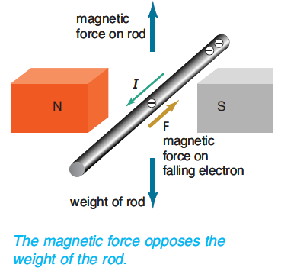
Generators
The induced current in the falling rod means that when the electrons are in the rod they are moving in two directions - downwards with the rod and along the rod.
The downward movement produced the sideways force along the rod that keeps the current going. But if the electrons are
also moving along the rod, then the magnetic field
exerts a second force on the electrons.
This magnetic force opposes the accelerating
force of the weight of the rod.

Slide 61
Generators
Note: To have a wire hover then the weight of the rod must equal the magnetic force applied by the electron flow in the rod.
F_{B} = F_{g}
I l B⊥ = m g
Example 5.2a: What current will flow through
a rod 20 cm long with a mass 18 grams if it is
to hover between two opposing magnets. The
magnetic field from the magnets is 0.6 T.

Slide 62
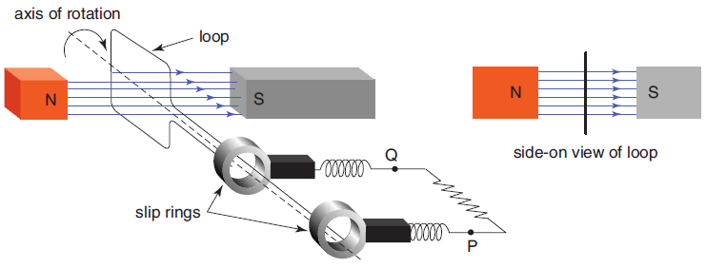
AC Generators
An AC Generator works by using a coil turning in a magnetic field. The action of motion of a wire through a magnetic field creates an EMF, hence a current.
Magnetic field + Motion → Electric field
When the loop is ‘face on’ to the magnetic field, the maximum amount of magnetic flux is passing through the loop. As the loop turns, the amount decreases. When
it has turned 90º, there is
no flux passing through it
at all.

Slide 63
AC Generators
As the loop continues to turn, the magnetic field passes through the loop from the other side: a negative amount of flux, from the point of view of the loop.
As the loop turns further still, the amount of magnetic flux passing through the loop reaches a negative maximum, then comes back to zero, and finally passes through the original face of the loop.

Slide 64
Electric Generation
Generation of electricity is achieved by inducing a current in a conductor by moving the coil in a magnetic field. When moved perpendicular to the magnetic field, then a maximum EMF is generated.
For a coil
φ = BA cos θ
φ = n B A sin θ
EMF (ε) = -N Δφ .
Δt
EMF (ε) = 2 π f n B A cos θ
cos 0 = 1 sin 0 = 0
cos 90 = 0 sin 90 = 1
cos 180 = -1 sin 180 = 0
cos 270 = 0 sin 270 = -1

Slide 65
Electric Generation
Example 5.2b: A coil is rotated 10 times every second in a magnetic field of 0.25 T. The coil is rectangular with sides 50 cm and 40 cm. Determine the average EMF generated.
Example 5.2c: A coil is rotated 15 times every second in a magnetic field of 0.25 T. The coil is circular with a radius of 25 cm. Determine the average EMF generated.

Slide 66
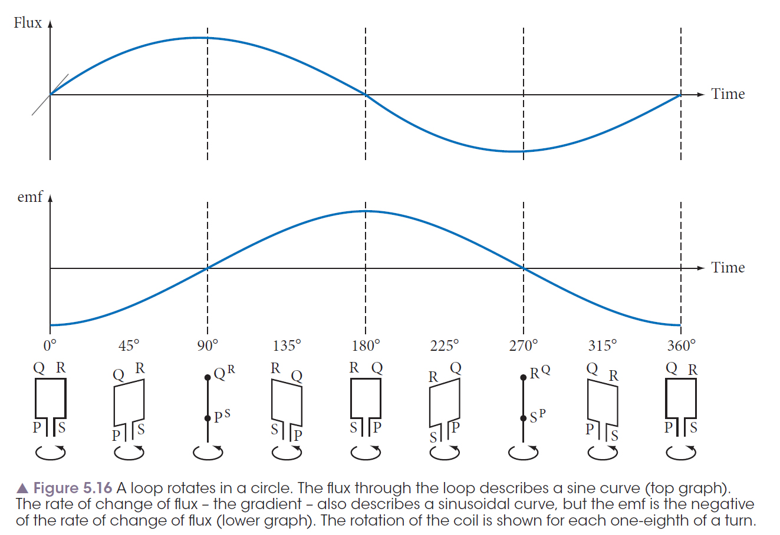
Electric Generation
cos 0 = 1 sin 0 = 0
cos 90 = 0 sin 90 = 1
cos 180 = -1 sin 180 = 0
cos 270 = 0 sin 270 = -1
For a coil
φ = n B A sin θ
EMF (ε) = 2 π f n B A cos θ

Slide 67
Electric Generation
Example 5.2d:
A piece of wire with an electrical resistance of 0.300 Ω is made into a continuous ring of radius 0.200 m and placed with it’s plane at right angles to a magnetic flux density of 0.700 T. The flux falls to zero uniformly in a time of 0.130 s.
What is the value of the induced emf and the resulting current in the ring.
Sketch a graph to show the way in which the current in the ring varies with time before, during and after the decay of the flux. Label and scale the axes.

Slide 68
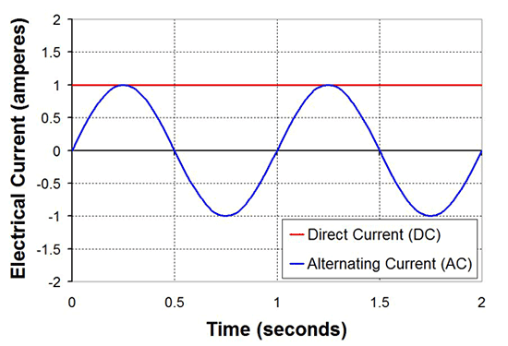
Electric Generation
Example 5.2e: Use the information from this current-time graph of a coil spinning between
magnets, if;
The number of turns
are doubled
The magnetic field
strength is doubled
The speed of rotation
is doubled.

Slide 69
AC Generators
The amount of magnetic flux passing through the loop varies like a sine wave. The induced EMF across the ends of the loop is equal to the change of magnetic flux with time.

Slide 70
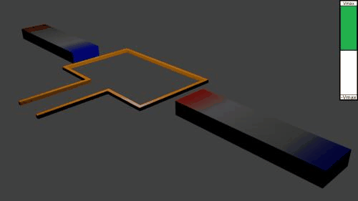
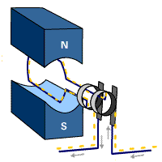
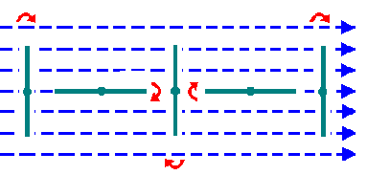
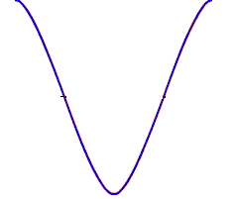
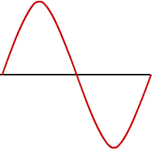
The
AC Generators
P
Q
P
F
I
E
L
D
Q
P
P
Q
Q
P
Q
flux Φ
time
+
emf
time
-
The EMF is the change in flux

Slide 71
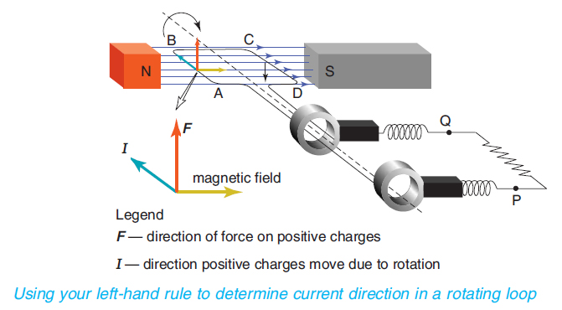
AC Generators
Using Lenz’s Law
Use the Left Hand Rule to determine the direction of current given that with generators the direction of rotation and the direction of magnetic field are already known.
The sinusoidal emf drives current through the external circuit first one way, then the opposite way, and is thus called alternating current (AC).

Slide 72
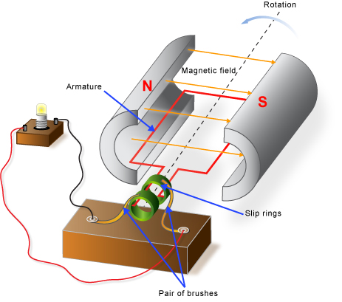
Generator Components
Magnetic field
This field envelops the armature and the
current generated within it. It is created by
permanent magnets or electromagnets.
Armature
The armature is a coil of wire generally
consisting of many windings mounted on a
shaft.
Slip rings
These are two current-conducting metal rings. They provide a conducting path for induced current in the armature to the external circuit. The output current is AC.

Slide 73
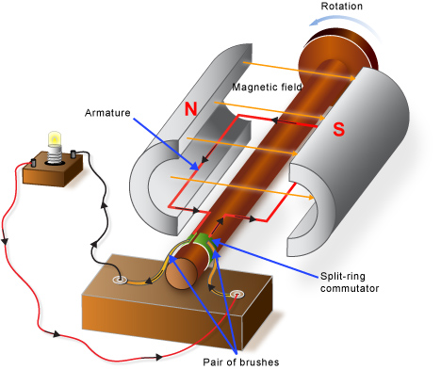
Generator Components
A pair of brushes
The brushes are contacts pressing lightly
against the slip rings. They provide the
conducting path for the current from the
armature to the external circuit or 'load'.
Rotating armature
The armature is rotated by an external
device (eg wind blades, engine)
Split-ring commutator
This is a current-conducting metal ring. It provides a conducting path for induced current in the armature. The output current is DC in this case.

Slide 74
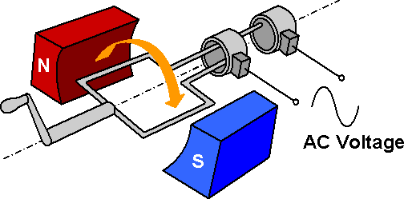
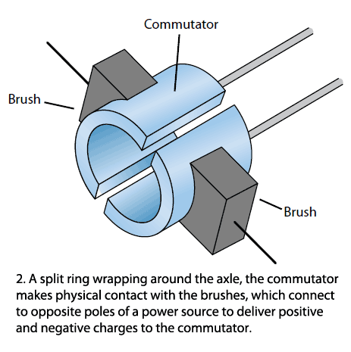
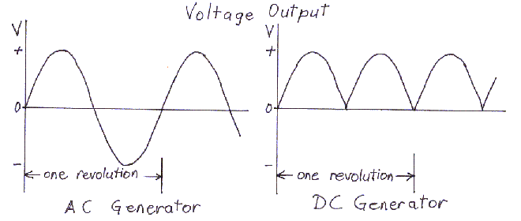
AC Generators v’s DC Generators
Slip Rings v’s Split Ring

Slide 75
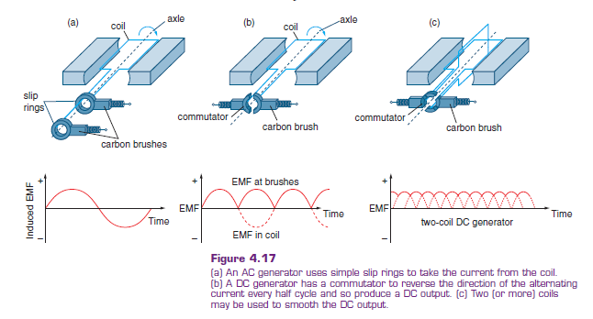
AC Generators v’s DC Generators

Slide 76
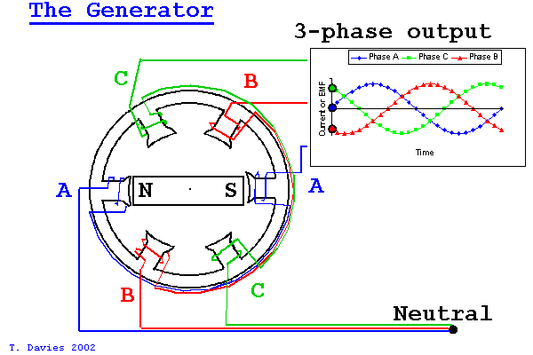

Three Phase Power

Slide 77


Three Phase Power with an Electromagnet
The light remains constantly bright
EMF_{min}
EMF_{min}

Slide 78


Single Phase Power
With single phase, there is a continuous voltage oscillation every 180º. This causes noticeable dimming in the light.

Slide 79


Power Lines

Slide 80

Power Lines

Slide 81
Voltage
From AS/NZS 3000:2007 (Clause 1.4.98)
Voltage Definitions | Range
Extra-low voltage | Not exceeding 50 V a.c. or 120 V ripple-free d.c.
Low voltage | Exceeding extra-low voltage, but not exceeding 1 000 V a.c. or 1 500 V d.c.
High voltage | Exceeding low voltage.

Slide 82
Homework, Context & Keywords
Context: How is this content used to better society?
Generating electricity to power and supply everyday objects

Slide 83
Homework, Context & Keywords
Key Words
AC Generator
DC Generator
Lenz’s Law
EMF
Magnetic Flux
Left Hand Rule
Magnetic Field
Armature
Slip Rings
Split Rings
Brushes
Three Phase Power

Slide 84
Homework, Context & Keywords
Homework
Complete all questions from Set 5.2 - due first lesson next week.
Read Chapter 5.3, page 141-145 and answer
Q1 Set 5.3
by next lesson.

Slide 85
Page Setup
Set up the first page of every lesson like this and rule a column line for every page after the first page that is used during the lesson.
Focus: State the Chapter Number, Title and the page numbers
(3 lines).
Keywords: During the lesson write out your own keywords used during the lesson. (8 lines)
Context: During the lesson write in this section what this topic relates to in the ‘real’ world. How is this content used to better society? (5 lines)

Slide 86
TRANSFORMERS
Chapter 5.3
Page 141 - 145

Slide 87


Transformers
A transformer consists of two coils, either interwoven or linked by an iron core. A changing EMF in one induces an EMF in the other.
The ratio of the EMF is equal to the ratio of the number of turns in each coil:
This is a step-up transformer – the EMF in the secondary coil is larger than the EMF in the primary.

Slide 88

Transformers
Energy must be conserved; therefore, in the absence of losses, the ratio of the currents must be the inverse of the ratio of turns:
Hence N_{P} = V_{P} = I_{S} .
N_{S} V_{S} I_{P}

Slide 89

Transformers
The alternating current in the primary coils creates a varying magnetic flux in the transformers core, thus creating a varying magnetic field through the secondary coil. The varying magnetic field induces a varying EMF, hence creating an AC current in the secondary coil.
I_{P} → φ_{P} → B_{S} → ε_{S} → I_{S}
N_{P} > N_{S} → Step Down
N_{S} > N_{P} → Step Up
A soft iron core is used to increase the flux. An increase in flux is an increase in the EMF.

Slide 90
Transformers
Example 5.3a: If a primary coil had 500 turns and a voltage of 240 V. What is the voltage in the secondary coil if it had 50 turns? Is the set up a step-up or step-down transformer?

Slide 91

Relative Motion of Current
The AC current in the secondary coil is 180º out of phase with the primary coil.

Slide 92
Australian Electricity
In Australia, electricity has to travel long distances between the power plant and the area of demand. According to synergy (2011), Perth has a peak usage during Summer of 3000 MW. At 240 V, standard appliances, then the current would be;
P = V I
3000 x 10⁶ = 240 x I
I = 1.25 x 10⁷ A
No reasonable conductor of electricity could carry such a large amount of current over large distances (electrocution would occur every time someone walked under the power lines)

Slide 93

Australian Electricity
So voltage is increased, power is constant and hence the current decreases.
Certain “mains” power lines in Perth carry about 330 kV to 500 kV with a current of 6000 A.
440 V – 20,000 V
Converted at the Power Station
220 kV – 500 kV Travel long distances
2400 V – 330 kV Rural and Outer Suburbs
240 V
Household Usage

Slide 94
Power Lines

Slide 95
Power Loss in Power Lines
Electricity can only travel in a wire for a certain distance before the resistance becomes too great and the current stops flowing. Electricity meeting resistance often converts to heat, light and/or sound, known as Power loss.
Power loss P_{loss} = I² R, so the current has to decrease to decrease the power loss. If it gets too hot then the wire will break (e.g. Fuses)
To decrease the resistance then the power lines will have to increase in thickness, adding to the weight and cost or use better conductors, but these are often “precious” metals and cost.

Slide 96

Faradays and Lenz’s Laws
Faraday – induction of a field created by the flow of electrons in the primary coil and the iron core.
Lenz – opposing force results in a flow of electrons in the secondary coil.

Slide 97

Transformer Summary

Slide 98

Eddy Currents
The changing magnetic flux in the iron core of a transformer above will induce an EMF, not only in the primary and secondary windings, but also in the iron core.
The iron core is a good conductor, so the currents induced in a solid iron core will be large.
Furthermore, the eddy currents flow in a direction which, by Lenz's law, acts to weaken the flux created by the primary coil.

Slide 99

Eddy Currents
Losses due to Eddy currents can not be eliminated completely, but they can be greatly reduced. Instead of having a solid iron core as the magnetic core material of the transformer or coil, the magnetic path is "laminated".

Slide 100

Eddy Currents
These laminations are very thin strips of insulated (usually with varnish) metal joined together to produce a solid core. The laminations increase the resistance of the iron-core thereby increasing the overall resistance to the flow of the eddy currents, so the induced eddy current power-loss in the core is reduced, and it is for this reason why the magnetic iron circuit of transformers and electrical machines are all laminated.

Slide 101

Transformers
Example 5.3b: The diagram below shows a basic structure of a transformer.
Suggest a suitable material for the transformer core. Explain why this material is suitable.
Explain the other essential features of
the core.
Explain the purpose of the core.
Why is it necessary that the primary
input be AC?

Slide 102
Power Loss
Power loss is where the electricity is converted into other forms of energy during the transmission through the power lines
P_{loss} = ΔV I = I² R = ΔV²
R
Typically, power is transmitted at 220 kV to 330 kV in suburbs and outer city fringes. The heating losses are reduced at high voltage because the current is lower.

Slide 103
Power Loss
Example 5.3c: An AC generator produces 10 kW of power which is to be transmitted at 240 V down a line 5 km long and whose total resistance is 1.5 Ω. Calculate;
The power loss in the line.
The voltage at the end of the line.

Slide 104
Homework, Context & Keywords
Context: How is this content used to better society?
Converting electricity into a manageable quantity prevents the needs for massive cables to carry the electricity or the need for mini power stations which would be littered throughout the cities adding to local pollution.

Slide 105
Homework, Context & Keywords
Key Words
Transformers
Step-Up
Step-Down
Primary Coil
Secondary Coil
Laminate
Soft Iron Core
Power loss
Eddy Currents
Electricity Grid
Transportation of Electricity

Slide 106
Homework, Context & Keywords
Homework
Complete all questions from Set 5.3 - due first lesson next week.
Read Chapter 5.4, page 146-151 and answer
Q1 & Q2 Set 5.4
by next lesson.

Slide 107
Page Setup
Set up the first page of every lesson like this and rule a column line for every page after the first page that is used during the lesson.
Focus: State the Chapter Number, Title and the page numbers
(3 lines).
Keywords: During the lesson write out your own keywords used during the lesson. (8 lines)
Context: During the lesson write in this section what this topic relates to in the ‘real’ world. How is this content used to better society? (5 lines)

Slide 108
ELECTRIC MOTORS
Chapter 5.4
Page 146 - 151

Slide 109

Electric Motors
A DC motor (a simplified example of which is given in the figure below) uses the current from a battery flowing through a coil in a magnetic field to produce continuous rotation of a shaft.
Magnetic field + Electric field → Motion

Slide 110
Electric Motor
An electric motor uses electrical energy to produce movement.
The electric current in a magnetic field experiences a force.
F = n I l B⊥
F – magnet force (N)
n – number of “turns” in the coil

Slide 111

Electric Motor
Visual of a simple motor.
A current is passed through wires that are placed in a magnetic field. The perpendicular interaction between the field and the current creates a force. The direction of that force determines which way the coil turns.

Slide 112

Electric Motor
Determining the direction of rotation of this simple motor.
Step 1: Find the direction of the magnetic field.
Step 2: Find the direction of the current in the wire.
Step 3: Using the right hand rule determine the direction of the force in the wire and hence the rotation of the coil.
B
C
A
D
For wire AB
Field →
Current ●
Force ↑
For wire CD
Field →
Current ×
Force ↓
Hence coil is turning clockwise

Slide 113
Electric Motor
Example 5.4a: A 0.2 m length of wire through which a current of 2.5 A is flowing, experiences a total force of 5 x 10-2 N vertically downwards when at right angles to a magnetic field.
Draw a diagram showing the orientation of the field, current and the force.
Determine the magnitude of the magnetic field strength.
How could the force be increased?

Slide 114

DC Motors
When a coil is in position 1 (as shown in the figure below), the forces will make it rotate. As the coil rotates (position 2) the forces remain unchanged in size and direction. This is because the magnetic field and the current in the wire are still the same size and in the same direction. However, their lines of action are closer to the axle, so they have less turning effect (Torque).

Slide 115

DC Motors
When the coil reaches position 3, at right angles to the magnetic field, the forces are still unchanged in size and direction, but in this case the lines of action of the forces pass through the axle and have no turning effect. Since the coil was already moving before it got to position 3, the momentum of its rotation will carry it beyond position 3 to position 4(a). In position 4(a) the current is still travelling in the same direction, so in this position the forces will act to bring the coil back to position 3.

Slide 116
DC Motors
If this was the design of a DC motor, the coil would turn 90° and then stop!
If the coil was in position 3 when the battery was first connected, the coil would not even move. So, if the motor is to continue to turn, it needs to be modified when the coil reaches position 3. If the direction of the forces can be reversed at this point, as shown in position 4(b), the forces will make the coil continue to turn for another 180º. The coil will then be in the opposite position to that shown for position 3. The current is again reversed to complete the rotation.

Slide 117

DC Motors
The current needs to be reversed twice every rotation when the coil is at right angles to the magnetic field. This reversal is done with a commutator. The commutator consists of two semicircular metal pieces attached to the axle, with a small insulating space between their ends.
Metal brushes
Current is cut when “brushes” come in contact with (dark blue) insulating material, hence no force.
Supplied Electricity

Slide 118

Electric Motor Torque
τ = F w⊥ , where F = n I l B⊥
τ = Torque (N m)
F = Force (N)
w⊥ = Perpendicular distance
from the applied force
to the pivot point (m).

Slide 119

Electric Motor Torque
Example 5.4b: The coil shown in the figure below is 4.00 cm square and consists of 20 turns of wire and carries a current of 5.00 A in a field of 0.800 T.
a) What are the forces on each side?
b) What is the torque on the coil?
S
B
C
N
A
D

Slide 120


Electric Motor
The split ring commutator assures that the current on the left side of the pivot is always flowing in the same direction regardless of the coils position.

Slide 121

Induction Motor
Induction motors use wire loops on a rotating armature and obtain their torque from currents induced in these loops by the changing magnetic field produced in the stator (stationary) coils.
These coils are closed loops which have
large currents induced in them because of
their low resistance.
An induction motor must achieve a rotating
magnetic field to continue to exert a torque
on the armature coils. In this example, the
rotating field is achieved by the extra coils
on the pole pieces.

Slide 122
Generators versus Motors
Generators: Generate electricity using motion.
Motors: Motion using electricity.
The set up of a standard generator is where the coil is stationary and the magnet rotates around the coil. However, here we learn about the principles applied to small hobby motors where the magnet is stationary and the coil rotates. The outcome of current flow and induced EMF is the same.

Slide 123

Motors versus Generators
The Motor RHR The Generator LHR

Slide 124

Generators versus Motors
The Motor needs definite connection when the area of the coil is parallel with the magnetic field, hence maximum force is applied perpendicular to the rotation of the coil when electricity is applied. The Generator needs a connection when the EMF is at its maximum, hence needs definite connection when the area of the coil is moved to the parallel position with the magnetic field

Slide 125
Generators versus Motors
Example 5.4c: Distinguish between the motor principle and the generator principle.

Slide 126
Homework, Context & Keywords
Context: How is this content used to better society?
Developing a society devoid of manual labour
Helping to advance development by removing remedial duties that a simple motor and mechanism can do.

Slide 127
Homework, Context & Keywords
Key Words
DC Motor
Torque
Commutators
Induction motor

Slide 128
Homework, Context & Keywords
Homework
Complete all questions from Set 5.4 - due first lesson next week.
Read Chapter 5.5, page 152-158 and answer
Q1 & Q2 Set 5.5
by next lesson.

Slide 129
Page Setup
Set up the first page of every lesson like this and rule a column line for every page after the first page that is used during the lesson.
Focus: State the Chapter Number, Title and the page numbers
(3 lines).
Keywords: During the lesson write out your own keywords used during the lesson. (8 lines)
Context: During the lesson write in this section what this topic relates to in the ‘real’ world. How is this content used to better society? (5 lines)

Slide 130
EM RADIATION
Chapter 5.5
Page 146 - 151

Slide 131

Family of Electromagnetic Radiation

Slide 132

Family of Electromagnetic Radiation
Light is part of the electromagnetic family, each with its unique wavelength and corresponding frequency. All have the same velocity, known as the speed of light:
c = 3.00 x 10⁸ ms⁻¹.
Within the spectrum of light radiation the wavelength is varying.

Slide 133
Family of Electromagnetic Radiation
In 1864, James Maxwell, explained the electromagnetic nature of light. He proposed that an oscillating electric charge (or current) will produce an oscillating magnetic field, which in turns produces an oscillating electric charge. This process becomes self-sustaining at the speed 3.00 × 10⁸ m s⁻¹.
The electromagnetic force is one of the four fundamental interactions in nature. The other three fundamental interactions are the strong interaction, the weak interaction, and gravitation.
In a vacuum, observing a photon of light, it was found that the force acting on that photon is;
F = qE + qvB sinθ

Slide 134
Electromagnetic Radiation
Example 5.5a: A photon of light hits a particle of ozone in the upper atmosphere of the Earth near the equator and shears off two electrons. The ozone particle receives 20% of the photons kinetic energy and enters the atmosphere heading North at an angle 30º to the atmospheric layer. Given that the Earth has a magnetic field of 45 microtesla and an electric field in the upper atmosphere on that particular day of 150 N C⁻¹. What is the force that the ozone particle experiences as it moves through the upper atmosphere?

Slide 135


Family of Electromagnetic Radiation
Electro..... Magnetic!
c = f λ, where c is constant.

Slide 136
Electromagnetic Radiation
Example 5.5b: The SBS television station transmits its vision signal on 527.25 MHz and its sound signal on 532.75 MHz. What is the wavelengths of each of these signals?

Slide 137
Homework, Context & Keywords
Context: How is this content used to better society?
Electromagnetic radiation can be used as an energy source to manoeuvre or move objects in space, instead of fuel propellant. Hence craft can last longer in space.

Slide 138
Homework, Context & Keywords
Key Words
Electromagnetic Radiation
Electromagnetic Force
Speed of Light

Slide 139
Homework, Context & Keywords
Homework
Complete all questions from Set 5.5 - due first lesson next week.

